Slide 1
Neural Networks

Slide 2
Contents
Introduction
Simple Mathematical Model
What a Perceptron Can Do?
What a Neural Network Can Do?
Multilayer Perceptron
Error Back Propagation
Generalization and Overfitting
Advanced Topics
Concluding Remarks

Slide 3
Learning Algorithm (1)
Preparation for Learning
Given input-output data of the target function to learn
Given structure of network (# of nodes in hidden layer)
Randomly initialized weights
(x₁₁, x₁₂, x₁₃, …, y₁)
(x₂₁, x₂₂, x₂₃, …, y₂)
…
(x_{n1}, x_{n2}, x_{n3}, …, y_{n})
Given
data
A Network after
learning
the given data
Learning
Algorithm
An Initial Network
Neural
network
What are different??

Slide 4
Learning Algorithm (2)
Basic Idea of Learning
The function :
The output of a neural network:
Neural network after learning:
Learning:
A process to find weights so that
for all x
for all x

Slide 5
Learning Algorithm (3)
Basic Idea of Learning
Find weights so that
Find weights which minimize
for all x
or

Slide 6
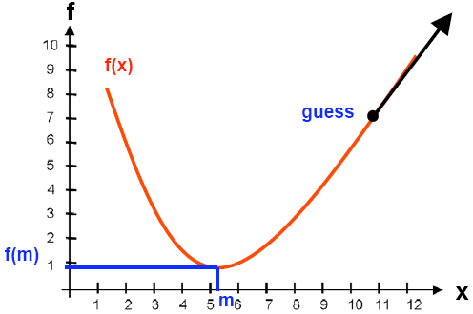
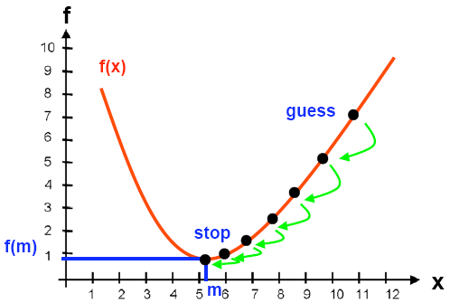
Learning Algorithm (4)
Find x which minimizes f(x)
if we cannot solve

Slide 7
Learning Algorithm (5)
Gradient Descent Method
Repeat
Determine a descent direction
Choose a step
Update
Until stopping condition is satisfied
In a mathematical form
Do the followings until f’(x) = 0
learning rate

Slide 8
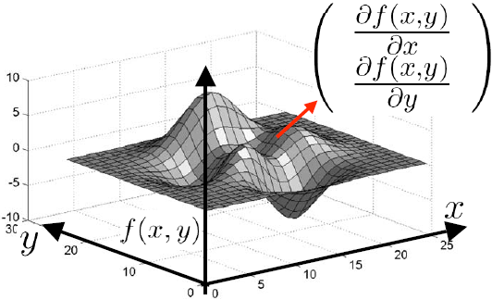
Learning Algorithm (6)
Gradient Descent Method
Multi-dimension

Slide 9
Error Back Propagation (1)
Error Back Propagation
ANN learning algorithm based on gradient descent method
Using derivatives to change the weights so that the error is minimized
Hard limit is not differentiable. -> Sigmoid
Sigmoid
x₁
w₁
y
x₂
∑
f
1
f
…
w₂
w_{n}
x_{n}
0
s
net = x₁w₁ + x₂w_{j2} + … + x_{n}w_{n}
y = sigmoid(net)

Slide 10
Error Back Propagation (2)
Sigmoid function
1
1/2

Slide 11
Error Back Propagation (3)
Basic Idea
Given input-target pairs and output of NN
Minimize the error
D₁=( x₁₁, x₁₂, …, x_{1d}, t₁₁ , t₁₂, …, t_{1m})
D₂=( x₂₁, x₂₂, …, x_{2d}, t₂₁ , t₂₂, …, t_{2m})
…
D_{N}=( x_{N1}, x_{N2}, …, x_{Nd}, t_{N1} , t_{N2}, …, t_{Nm})
( o₁₁, o₁₂, …, o_{1m})
( o₂₁, o₂₂, …, o_{2m})
…
( o_{N1}, o_{N2}, …, o_{Nm})
inputs
targets
Outputs of NN
where

Slide 12
Error Back Propagation (4)
Remind Error Function
D_{n}=( x_{n1}, x_{n2}, …, x_{nd}, t_{n1} , t_{n2}, …, t_{nm})
( o_{n1}, o_{n2}, …, o_{nm})
x_{n1}
o_{n1}
w_{ji}
h_{nj}
w_{kj}
x_{ni}
j
k
o_{nk}
…
…
…
x_{nd}
o_{nm}
h_{np}
input
hidden
output
So, you can evaluate
and

Slide 13
Error Back Propagation (5)
Basic Idea
Remember
So, we need to evaluate:
Two cases
Case 1: when w is between output and hidden layer
Case 2: when w is between hidden and input layer
because

Slide 14
Error Back Propagation (6)
Case 1: Weights between output and hidden layer
For D_{n}=( x_{n1}, x_{n2}, …, x_{nd}, t_{n1} , t_{n2}, …, t_{nm})
x_{n1}
o_{n1}
h_{nj}
w_{kj}
x_{ni}
j
k
o_{nk}
…
…
…
x_{nd}
o_{nm}
h_{np}
input
hidden
output

Slide 15
Error Back Propagation (7)
Case 1: Weights between output and hidden layer
x_{n1}
o_{n1}
h_{nj}
w_{kj}
x_{ni}
j
k
o_{nk}
…
…
…
x_{nd}
o_{nm}
h_{np}
input
hidden
output

Slide 16
Error Back Propagation (8)
Case 1: Weights between output and hidden layer –con’d

Slide 17
Error Back Propagation (9)
Case 1: Weights between output and hidden layer –con’d

Slide 18
Error Back Propagation (10)
Case 2: Weights between hidden and input layer
For D_{n}=( x_{n1}, x_{n2}, …, x_{nd}, t_{n1} , t_{n2}, …, t_{nm})
x_{n1}
o_{n1}
w_{ji}
w_{kj}
x_{ni}
j
k
o_{nk}
…
…
…
x_{nd}
o_{nm}
input
hidden
output

Slide 19
Error Back Propagation (11)
Case 2: Internal weights – con’d

Slide 20
Error Back Propagation (12)
Case 2: Internal weights – con’d

Slide 21
Error Back Propagation (13)
Weights between deep layers
For D_{n}=( x_{n1}, x_{n2}, …, x_{nd}, t_{n1} , t_{n2}, …, t_{nm})
w_{pq}
w_{ip}
w_{ji}
w_{kj}
net_{np}
h_{np}
net_{ni}
h_{ni}
net_{nj}
h_{nj}
net_{nk}
h_{nk}
E
…
…
…
…
…
…
…
…
Hidden Layer
Hidden Layer
Hidden Layer
Hidden Layer

Slide 22
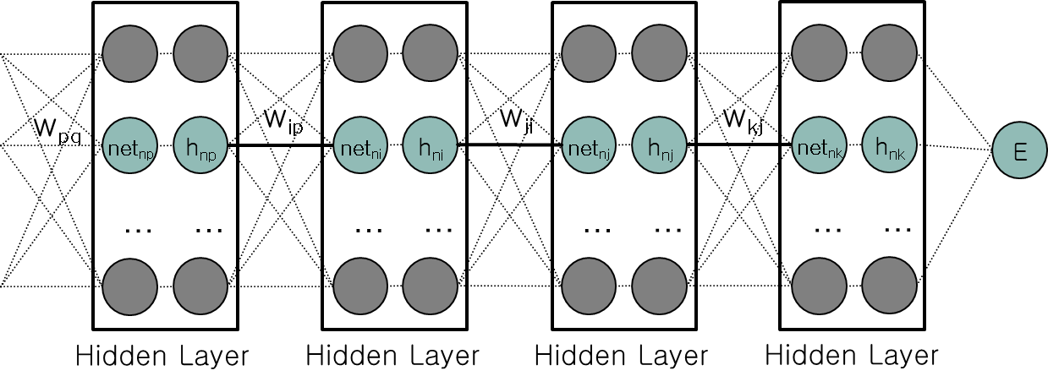









Error Back Propagation (14)
Weights between deep layers
$$\frac{∂E}{∂w_{kj}}=\frac{∂E}{∂{net}_{nk}}\frac{∂{net}_{nk}}{∂w_{kj}}$$
$$=δ_{k}h_{nj}$$
$$δ_{k}=\frac{∂E}{∂{net}_{nk}}$$
$$\frac{∂E}{∂w_{ji}}=\frac{∂E}{∂{net}_{nj}}\frac{∂{net}_{nj}}{∂w_{ji}}$$
$$=δ_{j}h_{ni}$$
$$δ_{j}=\frac{∂E}{∂{net}_{nj}}$$
$$\frac{∂E}{∂w_{ip}}=\frac{∂E}{∂{net}_{ni}}\frac{∂{net}_{ni}}{∂w_{ip}}$$
$$δ_{i}=\frac{∂E}{∂{net}_{ni}}$$
$$=δ_{i}h_{np}$$

Slide 23
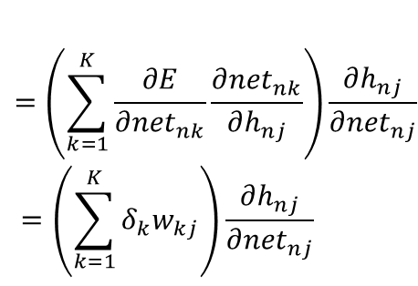

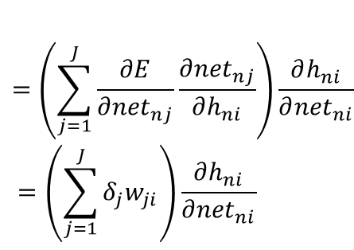


Error Back Propagation (15)
Weights between deep layers
$$δ_{k}=\frac{∂E}{∂{net}_{nk}}=\frac{∂E}{∂h_{nk}}\frac{∂h_{nk}}{∂{net}_{nk}}$$
$$δ_{j}=\frac{∂E}{∂{net}_{nj}}=\frac{∂E}{∂h_{nj}}\frac{∂h_{nj}}{∂{net}_{nj}}$$
$$δ_{i}=\frac{∂E}{∂{net}_{ni}}=\frac{∂E}{∂h_{ni}}\frac{∂h_{ni}}{∂{net}_{ni}}$$
$$=\left(\sum_{k=1}^{K}{\frac{∂E}{∂{net}_{nk}}\frac{∂{net}_{nk}}{∂h_{nj}}}\right)\frac{∂h_{nj}}{∂{net}_{nj}}$$
$$=\left(\sum_{k=1}^{K}{δ_{k}w_{kj}}\right)\frac{∂h_{nj}}{∂{net}_{nj}}$$
$$=\left(\sum_{j=1}^{J}{\frac{∂E}{∂{net}_{nj}}\frac{∂{net}_{nj}}{∂h_{ni}}}\right)\frac{∂h_{ni}}{∂{net}_{ni}}$$
$$=\left(\sum_{j=1}^{J}{δ_{j}w_{ji}}\right)\frac{∂h_{ni}}{∂{net}_{ni}}$$

Slide 24






Error Back Propagation (16)
Weights between deep layers
$$\frac{∂E}{∂w_{kj}}=\frac{∂E}{∂{net}_{nk}}\frac{∂{net}_{nk}}{∂w_{kj}}=δ_{k}h_{nj}$$
$$δ_{k}=\frac{∂E}{∂h_{nk}}\frac{∂h_{nk}}{∂{net}_{nk}}$$
$$δ_{j}=\left(\sum_{k=1}^{K}{δ_{k}w_{kj}}\right)\frac{∂h_{nj}}{∂{net}_{nj}}$$
$$\frac{∂E}{∂w_{ji}}=\frac{∂E}{∂{net}_{nj}}\frac{∂{net}_{nj}}{∂w_{ji}}=δ_{j}h_{ni}$$
$$δ_{i}=\left(\sum_{j=1}^{J}{δ_{j}w_{ji}}\right)\frac{∂h_{ni}}{∂{net}_{ni}}$$
$$\frac{∂E}{∂w_{ip}}=\frac{∂E}{∂{net}_{ni}}\frac{∂{net}_{ni}}{∂w_{ip}}=δ_{i}h_{np}$$

Slide 25




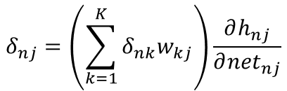
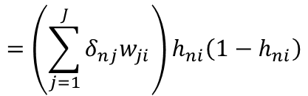

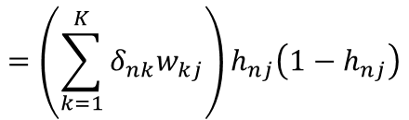


Error Back Propagation (16)
Weights between deep layers
If
$$h=Sigmoid\left(net\right)$$
$$\frac{∂E}{∂w_{kj}}=\frac{∂E}{∂{net}_{nk}}\frac{∂{net}_{nk}}{∂w_{kj}}=δ_{nk}h_{nj}$$
$$δ_{nk}=\frac{∂E}{∂h_{nk}}\frac{∂h_{nk}}{∂{net}_{nk}}$$
$$=−\left(t_{n}−h_{nk}\right)h_{nk}\left(1−h_{nk}\right)$$
$$δ_{nj}=\left(\sum_{k=1}^{K}{δ_{nk}w_{kj}}\right)\frac{∂h_{nj}}{∂{net}_{nj}}$$
$$=\left(\sum_{k=1}^{K}{δ_{nk}w_{kj}}\right)h_{nj}\left(1−h_{nj}\right)$$
$$\frac{∂E}{∂w_{ji}}=\frac{∂E}{∂{net}_{nj}}\frac{∂{net}_{nj}}{∂w_{ji}}=δ_{nj}h_{ni}$$
$$δ_{ni}=\left(\sum_{j=1}^{J}{δ_{nj}w_{ji}}\right)\frac{∂h_{ni}}{∂{net}_{ni}}$$
$$=\left(\sum_{j=1}^{J}{δ_{nj}w_{ji}}\right)h_{ni}\left(1−h_{ni}\right)$$
$$\frac{∂E}{∂w_{ip}}=\frac{∂E}{∂{net}_{ni}}\frac{∂{net}_{ni}}{∂w_{ip}}=δ_{ni}h_{np}$$

